Slide 1
Vestibular Apparatus
Dr Deepa.G.S
Associate Professor
SKHMC
Kulasekharam

Slide 2
Balance
Balance is the ability to maintain the body’s center of mass over its base of support
Maintaining balance depends on information received by the brain from three peripheral sources: eyes, muscles and joints, and vestibular organs

Slide 4
Vestibular apparatus
Vestibular apparatus is the part of labyrinth or
Inner ear
Each vestibular apparatus consists of two sac
like structures called utricle and saccule and
three semicircular canals
Semicircular canals open into utricle through
five openings and utricle in turn to saccule

Slide 5
Vestibular apparatus
Picture courtesy :Guyton and Hall’s Text book of Medical Physiology

Slide 6
SEMICIRCULAR CANALS
Semicircular canals are the tubular structures
placed at right angles to each other.
1. Anterior or superior canal
2. Posterior canal
3. Lateral or horizontal or external canal
This type of arrangement represent the three axes
of rotation
Vertical
Anteroposterior
Transverse axes.

Slide 7
Position of semicircular canals
https://www.slideshare.net/vjorwal/0-inner-ear

Slide 8
SEMICIRCULAR CANALS
One pair of semicircular canals will be in
the same plane
These pairs are called synergistic pairs
They are right anterior canal and left posterior canal
Left superior and Right posterior canals
Two horizontal canals

Slide 9
Crista Ampullaris
The part where each canal open into utricle is an
enlargement called ampulla and in the ampulla
is the sense organ crista ampullaris
Crista ampullaris is formed by a receptor
epithelium (neuroepithelium),which consists of
hair cells, supporting cells and secreting
epithelial cells.

Slide 10
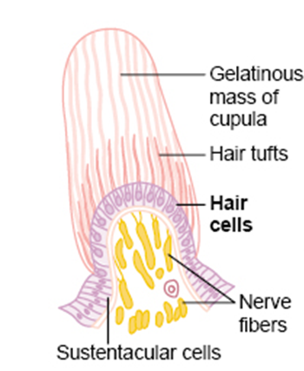
Crista Ampullaris
Cupula
From crista ampullaris, a dome-shaped gelatinous structure extends up to the roof of the ampulla. It isknown as cupula.
Cilia of hair cells are projected into cupula.
Picture courtesy :Guyton and Hall’s Text book of Medical Physiology

Slide 11
Cilia of hair cells
Apex of each hair cell has a cuticular plate.
From this plate, about 40 to 60 cilia arise, which are called stereocilia.
Each stereocilium is attached at its tip to the neighboring taller one by means of a fine process called tip link.
Because of the tip links, all the stereocilia are held together.
One of the cilia is very tall, which is named as kinocilium

Slide 12
Hair cell of the equilibrium apparatus and its synapses with the vestibular nerve.
Picture courtesy :Guyton and Hall’s Text book of Medical Physiology

Slide 13
Macula
Receptor organ in otolith organ is called macula formed by neuroepithelium and supporting cells.
Otolith Membrane
Like crista ampullaris, macula is also covered by a
gelatinous membrane called otolith membrane.
It is a flat structure and not dome shaped like cupula.
The stereocilia and kinocelium of each hair cell are embedded in otolith membrane.
Otolith membrane contains some crystals, which are called ear dust, otoconia or statoconia. Otoconia are mainly constituted by calcium carbonate.

Slide 14
Picture courtesy :Guyton and Hall’s Text book of Medical Physiology

Slide 15
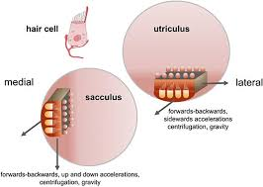
Macula
Situation of Macula
In utricle, the macula is situated
in horizontal plane,
so that the cilia from
hair cells are in
vertical direction.
In the case of saccule, macula is in vertical plane and the cilia are in horizontal direction
https://www.frontiersin.org/articles/10.3389/fncir.2019.00066/full

Slide 16
Nerve supply to vestibular apparatus
Impulses from the hair cells of Crista ampullaris
and maculae are transmitted to medulla
oblongata and other parts of central nervous
system (CNS) through the fibers of vestibular
division of vestibulocochlear (VIII cranial)
nerve.

Slide 17
Nerve supply to vestibular apparatus
First order neuron
Situation: Vestibular ganglion or Scarpa’s ganglion
Dendrites : Reach the receptor organs, i.e. crista
ampullaris and maculae
Axon: Form vestibular division of vestibulocochlear
nerve.
These fibers reach the medulla oblongata and
terminate in vestibular nuclei
Few fibers pass through vestibular nuclei and relay on
flocculonodular lobe of cerebellum

Slide 18
Vestibular nuclei
There are four vestibular nuclei in the medulla oblongata, viz. superior, inferior, lateral and medial nuclei.
Most of the primary vestibular fibers reaching superior and medial nuclei come from crista ampullaris
Lateral vestibular nucleus receives fibers mainly from maculae
Inferior vestibular nucleus receives fibers from both crista ampullaris and maculae

Slide 19
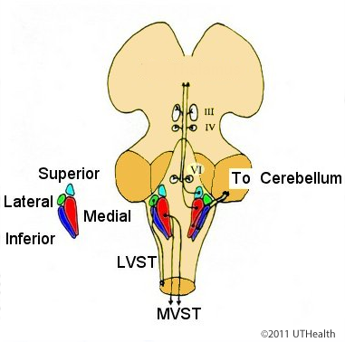
Vestibular nuclei
https://nba.uth.tmc.edu/neuroanatomy/L6/Lab06p18_index.html

Slide 20
Nerve supply to vestibular apparatus
Second order Neuron:
Axons from vestibular nuclei form the secondary vestibular fibers and forms four tracts:
1. Vestibulo-ocular tract
2. Vestibulospinal tract
3. Vestibuloreticular tract
4. Vestibulocerebellar tract.

Slide 21
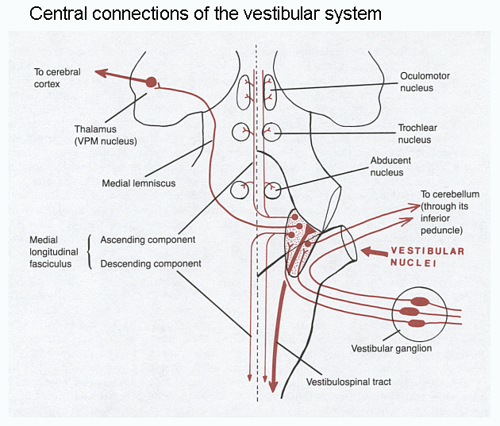
Connections of vestibular apparatus
Vestibulo-ocular tract
Origin: Superior, medial and inferior
Vestibular nuclei descend downward
for short distance and then ascend
through the medial longitudinal
Fasciculus
Terminaton: Nuclei of III, IV and VI
cranial nerves
Function:
This tract is concerned with movements
of eyeballs in relation to the position of
the head.

Slide 22
Connections of vestibular apparatus
2. Vestibulospinal Tract
ORIGIN: From lateral nucleus
Termination: Anterior horn
cells of spinal cord
FUNCTION:
Reflex movements of head
and body during postural
changes.

Slide 23
Connections of vestibular apparatus
3.Vestibuloreticular Tract
Some fibers from vestibular nuclei reach the
reticular formation of brainstem forming
reticulospinal tract.
Function:
These fibers are concerned with the facilitation
of muscle tone.

Slide 24
Connections of vestibular apparatus
4. Vestibulocerebellar Tract
Origin: from all four vestibular nuclei
Termination:Flocculonodular lobe and fastigial
nuclei of cerebellum.
Functions:
This tract is involved in coordination of
movements according to body position.

Slide 25
https://epomedicine.com/medical-students/vestibular-pathway-simplified/

Slide 26
Functions of vestibular apparatus
Semicircular canals- give response to rotatory
movements or angular acceleration of the head.
Utricle and saccule- give response to linear
acceleration of head.
Thus vestibular apparatus
Detects the position of head during different
movements.
Reflex adjustments in the position of eyeball, head and body during postural changes.

Slide 27
Functions of Semicircular canal
Angular acceleration stimulate crista in semicircular canal
One synergistic pair will be functioning depending on plane of movement
Stimulation occurs at the beginning and end of rotation
Activation occurs on one side and deactivation on other side which forms the basis of interpretation of direction of movement

Slide 28
Functions of Semicircular canal
In any semicircular canal, when cupula moves towards the ampulla, stereocilia of hair cells are pushed towards kinocilium leading to stimulation of hair cells.
When cupula moves away from ampulla, the stereocilia are pushed away from kinocilium and hair cells are not stimulated.

Slide 29
663.178.103.176/temas/temab2n/aportal/fisonercg/fisonerob4/oidoclayman/balance.htm

Slide 30
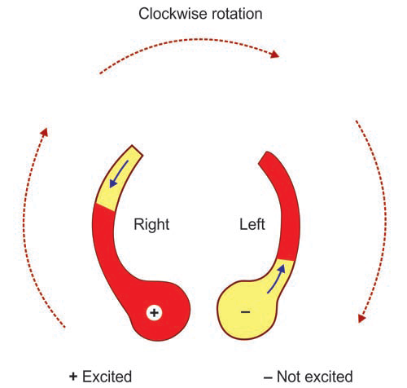
Mechanism of stimulation
Normal discharge-50-100 impulse/min
At the start of rotation
head rotates to one side
endolymph is displaced in a
direction opposite to the
direction of rotation
due to inertia for 20 sec
Fluid pushes ampulla
bending the hair cells
Impulse discharge-600-800/min
When a constant speed is achieved the fluid moves at the same rate as the body moving and ampulla swings back to original position

Slide 31
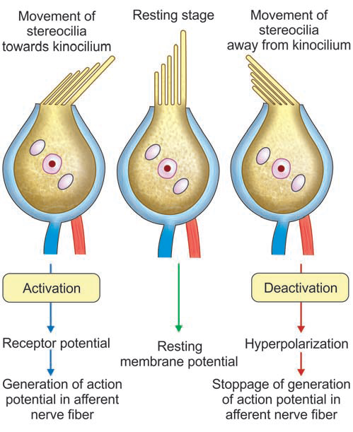
Mechanism of stimulation
In clockwise rotation in
horizontal plane,in
right semicircular canals
cupula moves towards
ampulla ,steriocilia towards
kinocilium leads to stimulation
In left semicircular canals
cupula moves away from
ampulla , steriocilia away from
kinocilium leads to deactivation

Slide 32
Mechanism of stimulation

Slide 33
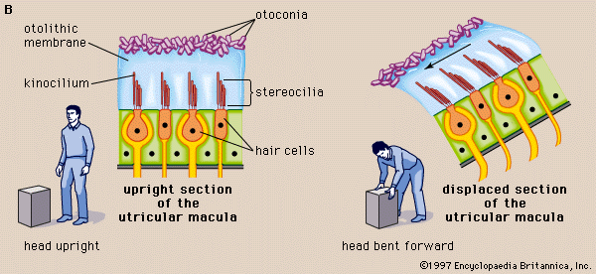
Utricle and saccule-Functions
Receptors (Macula) responds
to linear Acceleration
Utricle-horizontal plane
Saccule-vertical plane
Static receptors continually
stimulated by gravitational pull
During resting a particular pattern of firing
Tilt of even half a degree cause change in pattern of firing

Slide 34
Test for semicircular canals
Revolving Chair test or Barany Test
Caloric Test or ice water test
Test for utricle and saccule
Balancing test

Slide 35
Reference
1.Essentials of medical Physiology:K.sembulinhgam Prema sembulingam,Eigth edition
2.Comprehensive Textbook of medical Physiology,Gopal Krishna Pal,Pravati Pal,Nivedita Nanda.First edition
3.Textbook of Medical Physiology, Geetha N,second edition

Slide 36
THANK YOU

